Slide 1
Wildlife Trade Visualization
Ruyue zhang

Slide 2
Data resource
CITES Wildlife Trade Database: Kaggle
https://www.kaggle.com/cites/cites-wildlife-trade-database
comptab_2018-01-29 16_00_comma_separated.csv
67161 records
LIVING PLANET REPORT 2016:
https://www.worldwildlife.org/pages/living-planet-report-2016
Illegal Wildlife Trade Facts:
https://www.havocscope.com/illegal-wildlife-trade/

Slide 3
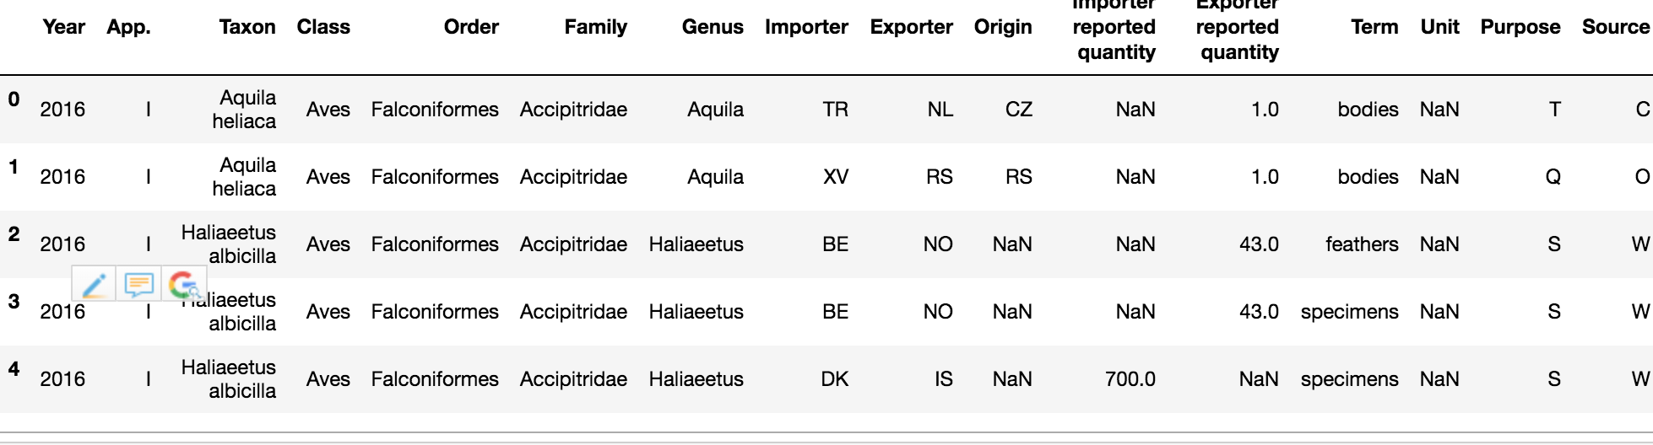
CITES Wildlife Trade Database
This visualization is mainly based on CITES Wildlife Trade Database. It records international legal wildlife trade from 2016 to 2017.

Slide 4
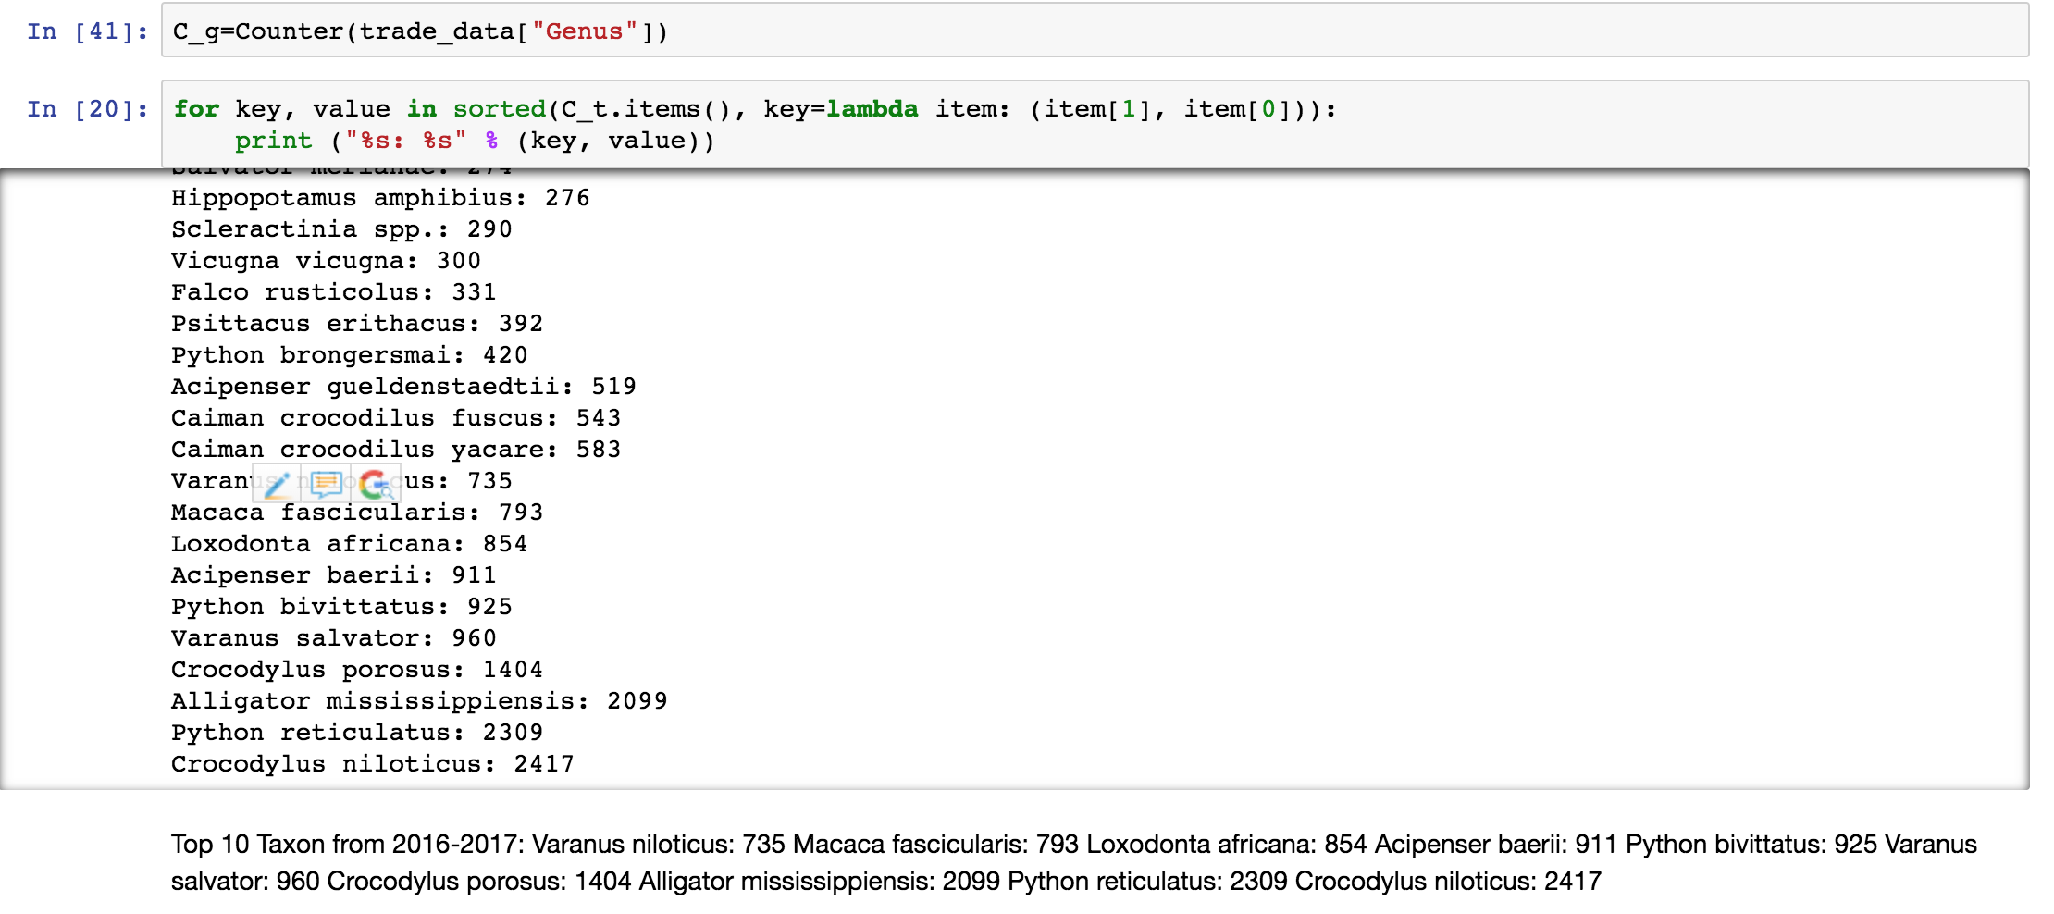
Data preparation
Calculation and modify for CITES Wildlife Trade data: Top 10 genus top 10 taxon top 10 terms

Slide 5
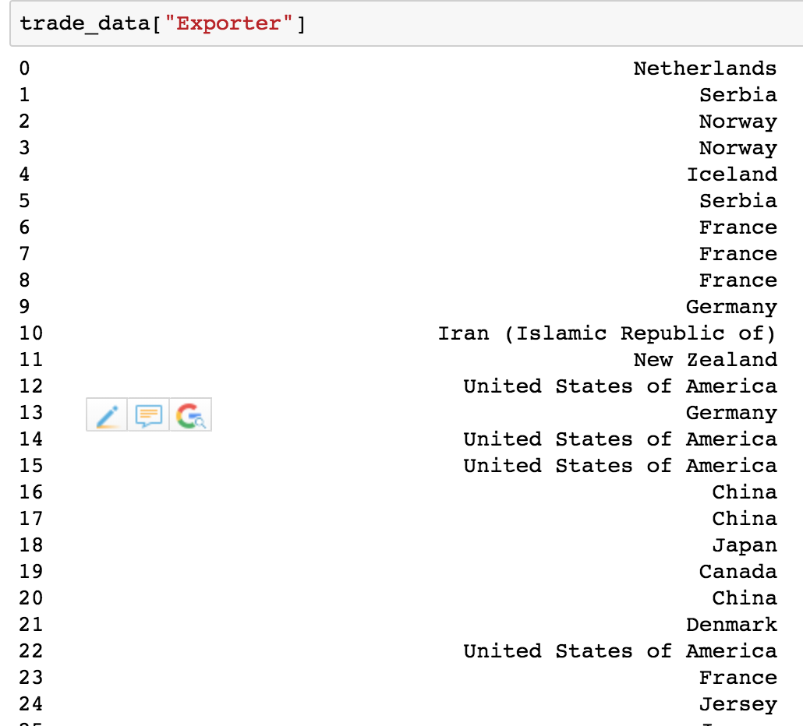

Slide 6
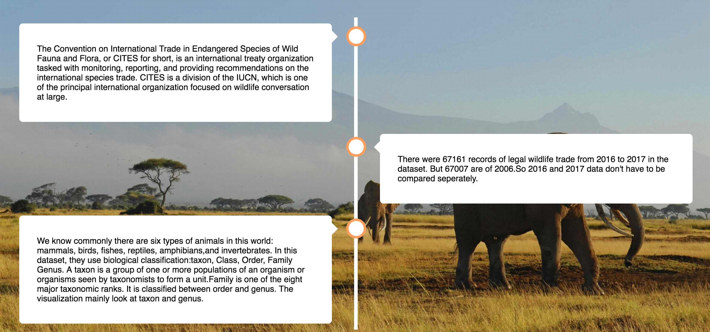
Structure
17 visualization in total
Started with timeline effects introducing the organization, the database and explaining some terminology for the animal species.

Slide 7
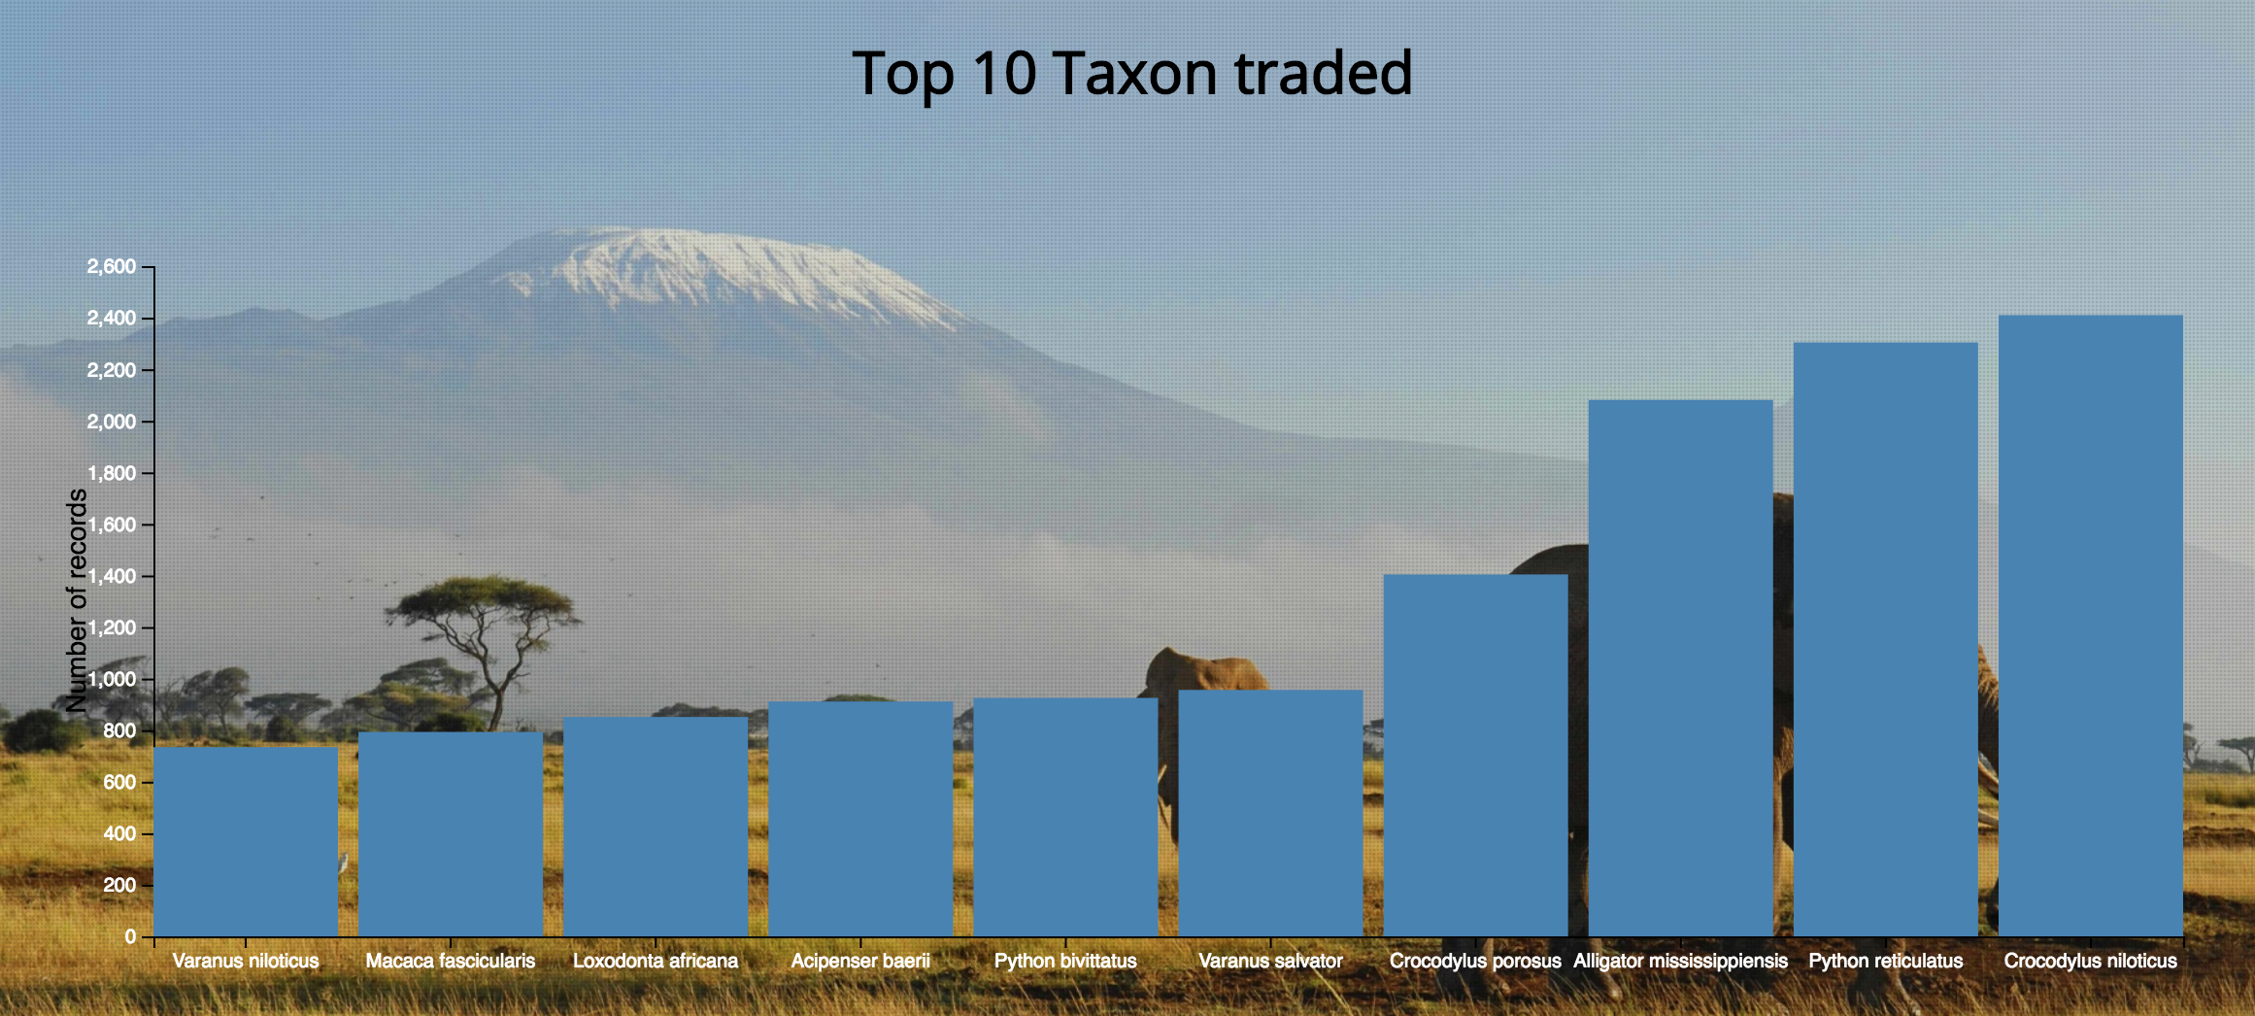
Top taxon and genus
The numbers of top 10 taxon traded ranges from around 700 to above 2400. There are four taxon traded above 1000 times. They are Crocodylus porosus, Alligator mississippiensis, Python reticulatus, Crocodylus niloticus. Crocodylus niloticus has the highest trade record which is 2410.

Slide 8
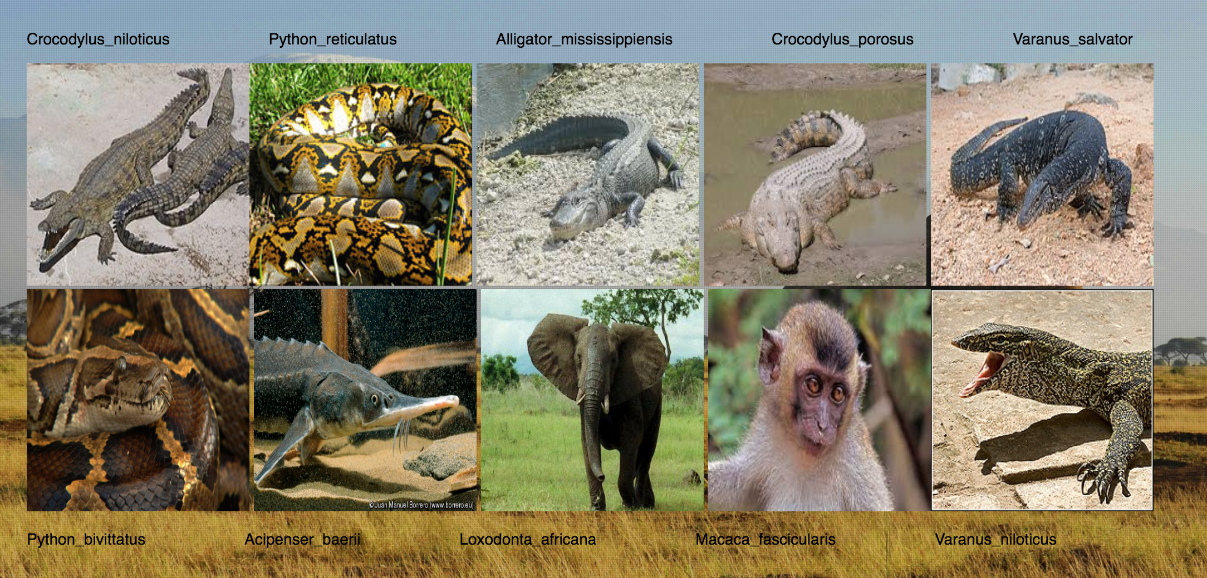
Top taxon and genus
From the top 10 taxon image, actually they are crocodile, alligator, python, elephant, monkey.

Slide 9
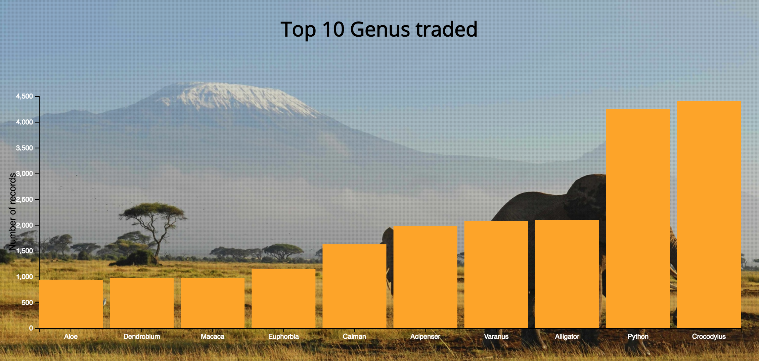
Top taxon and genus
The numbers of top 10 genus traded ranges from around 900 to above 4400. Python and Crocodylus had been traded over 4000 times. Crocodylus has the highest trade record.

Slide 10
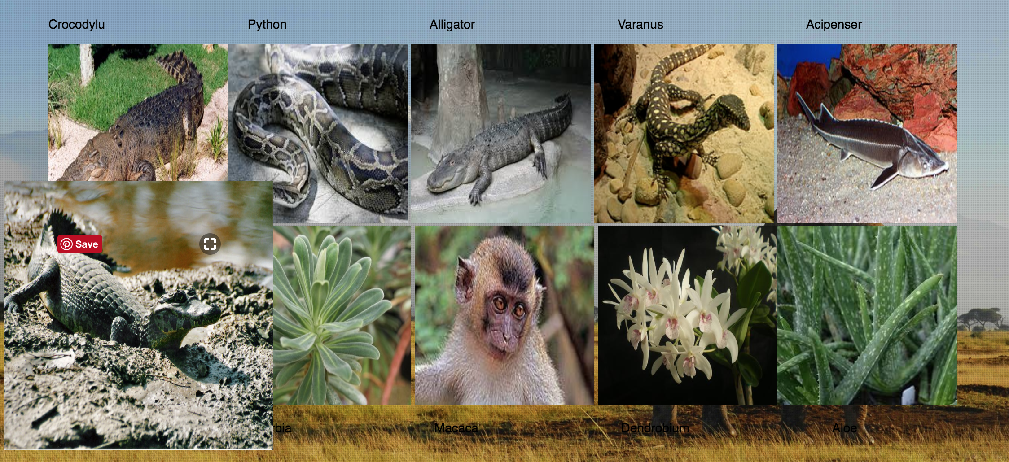
Top taxon and genus
From 10 genus image, there are still crocodile, python, alligator, monkey but also many plants.

Slide 11
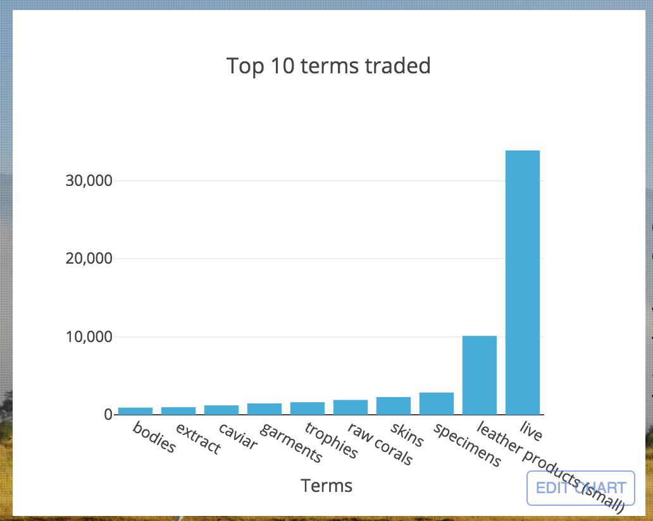
Top term traded and purpose
Most wildlife are traded as live, leather products with records more than 10000. Then specimens, skins, raw corals, trophies, garments, caviar, extract, bodies.

Slide 12
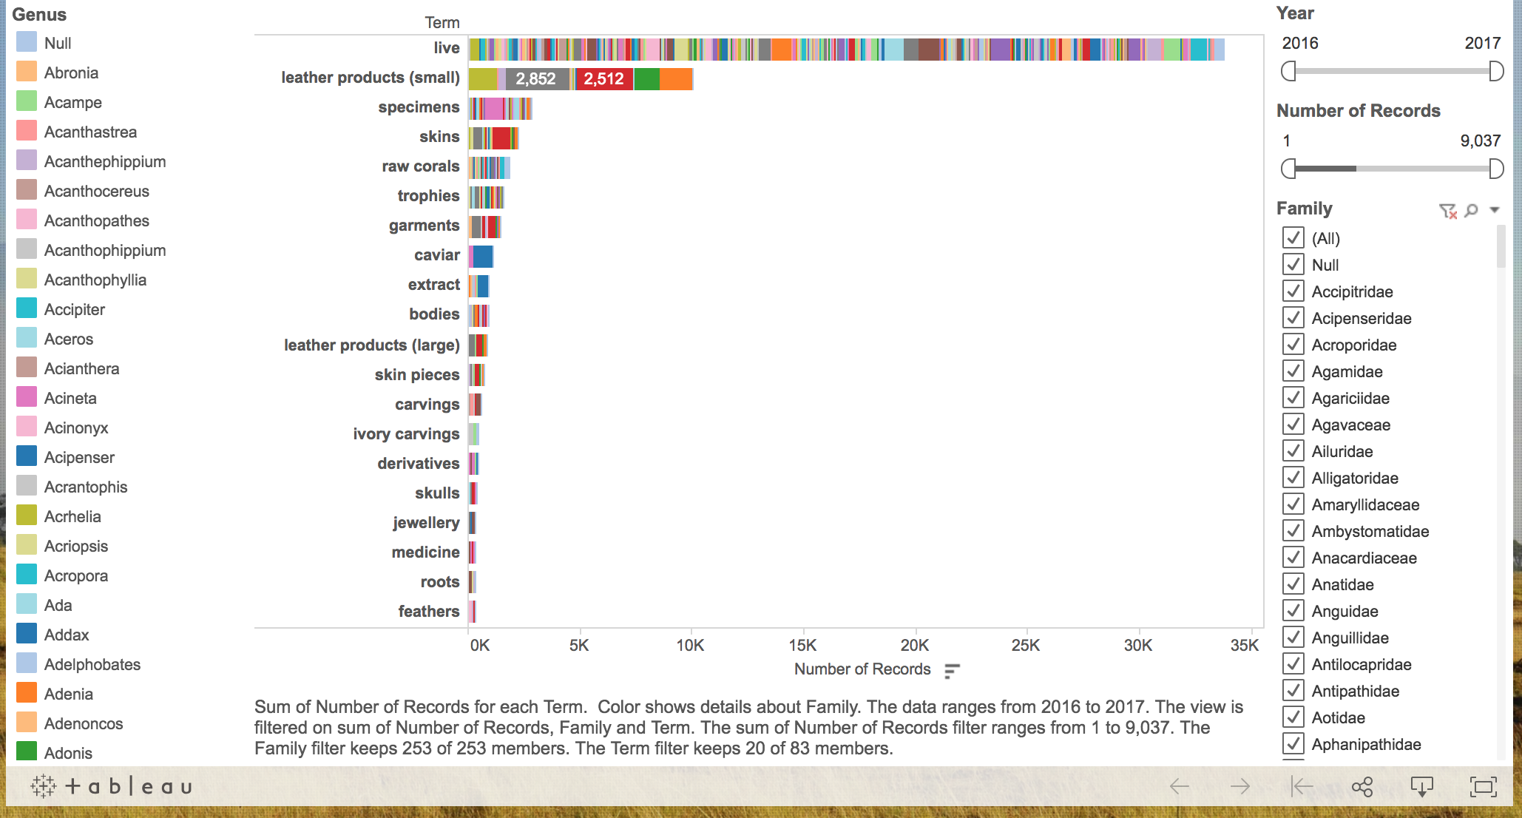
Top term traded and purpose
Among live, various genus were traded. Among leather products, Crocodylus, Python, Alligator, Varanus, Caiman were traded most. Among skin, Crocodylus was trades most again. To a degree, it explains why Crocodylus, Python, Alligator are most traded genus.

Slide 13
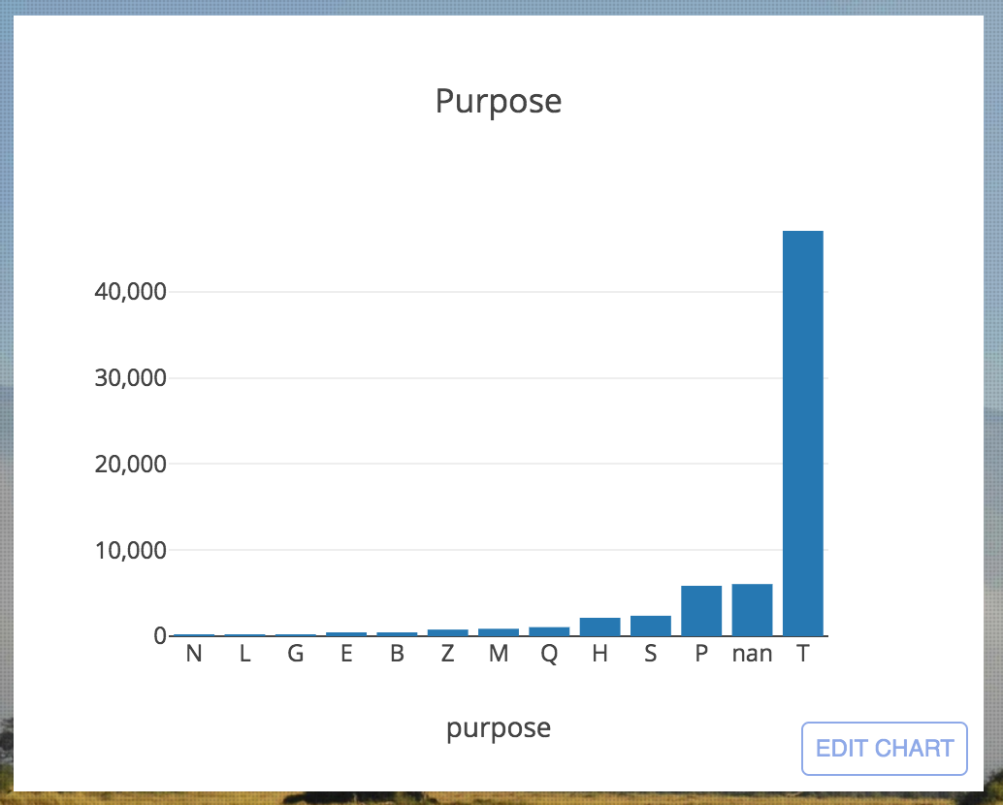
Top term traded and purpose
Most trades are for Commercial use.

Slide 14
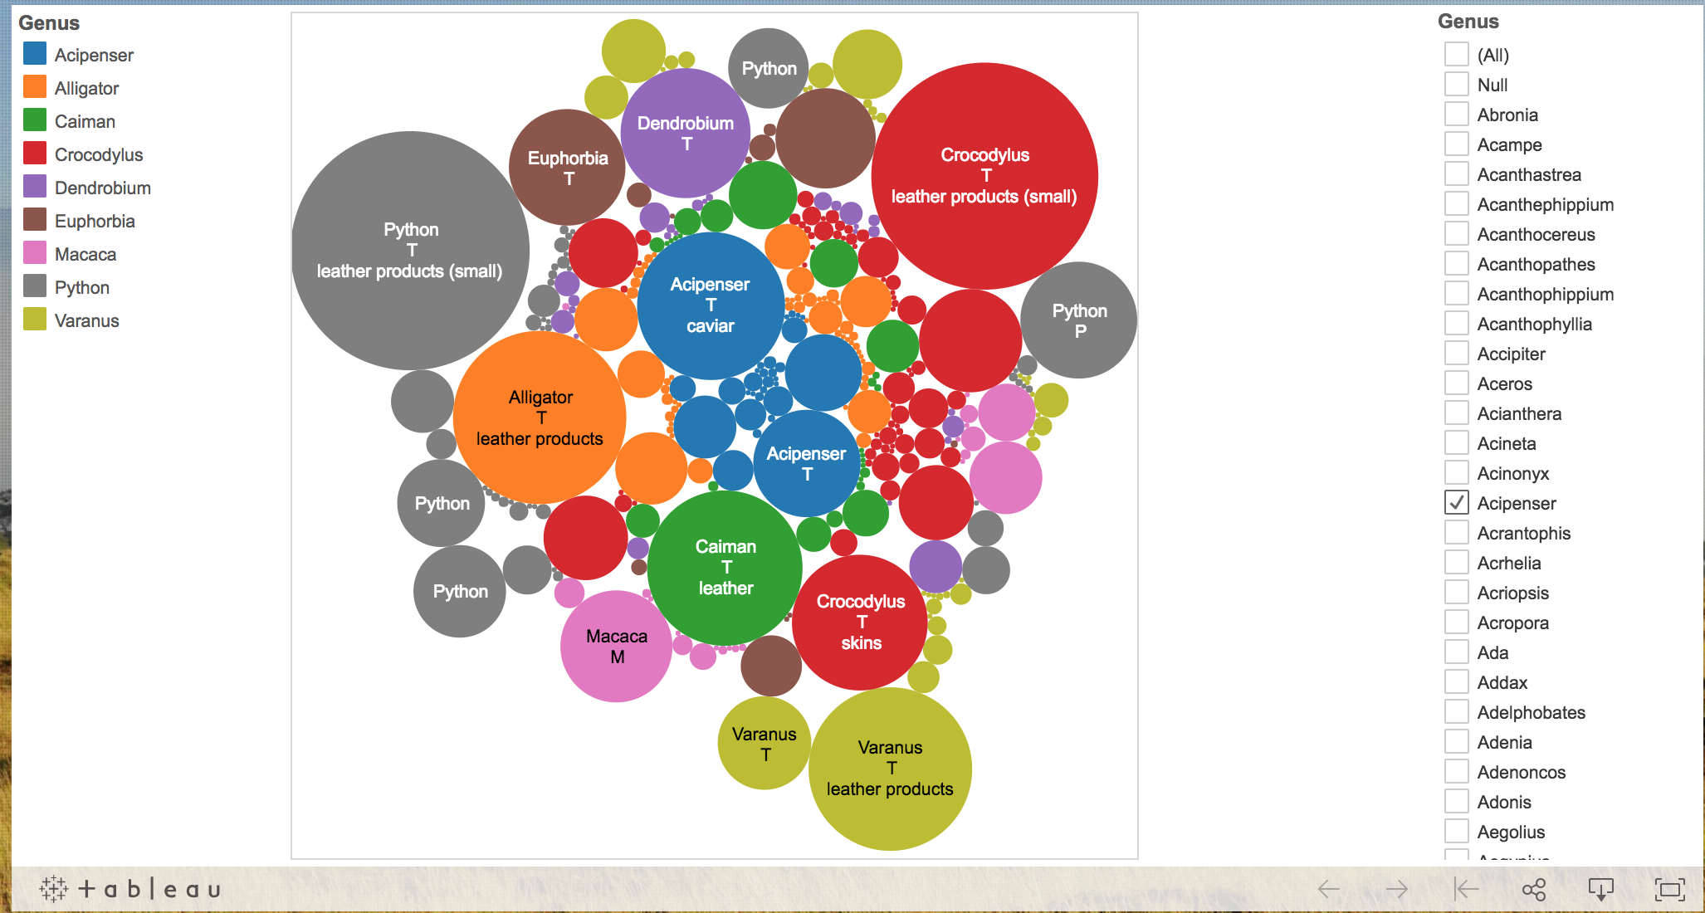
Top term traded and purpose
Among top 10 genus traded, most of they are for Commercial use and traded as leather products.

Slide 15
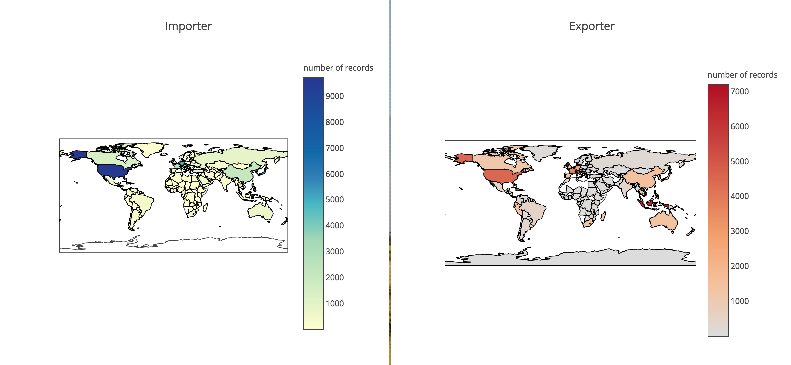
Import country and Export country
Most of the frequent importers are on the northern part of earth like America, Canada, East Asia, northern Europe. Frequent exporters are also in northern part including America, Canada, Northern Europe, China, then South East Asia.

Slide 16
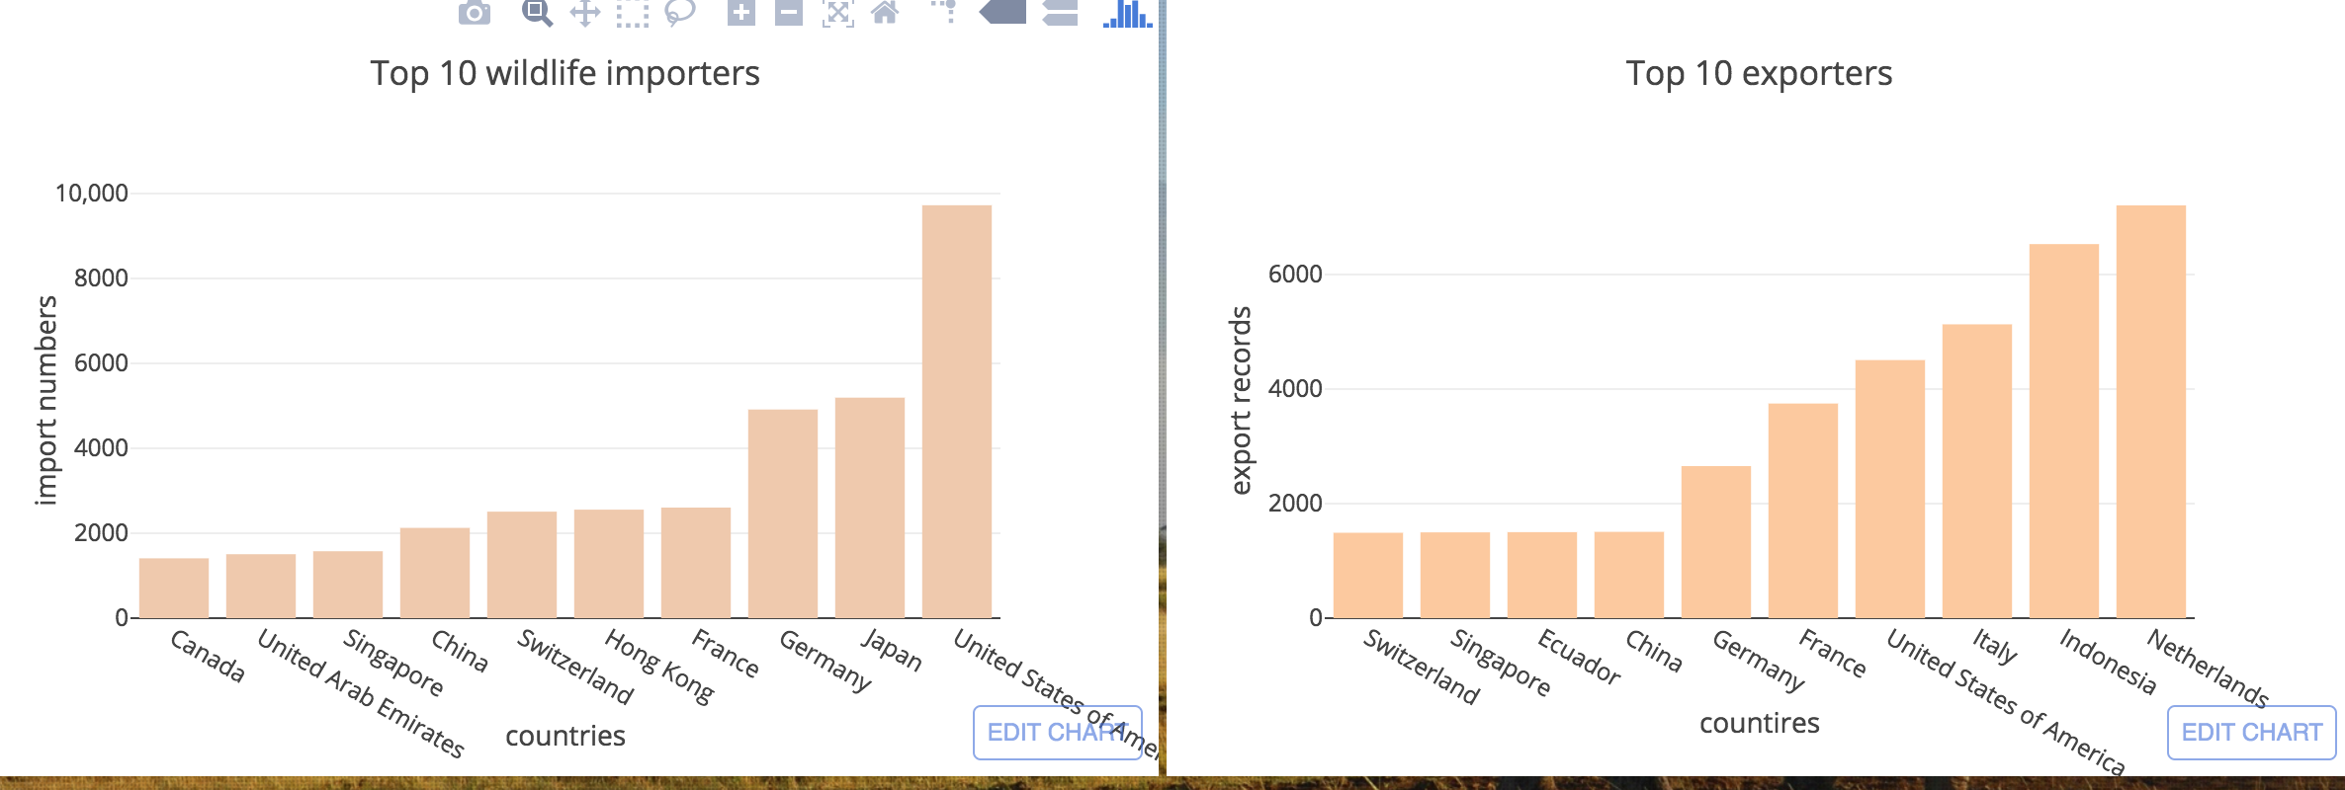
Import country and Export country
United States imported wildlife the Most. Netherlands ranks first in the export country, which is a little surprising.

Slide 17
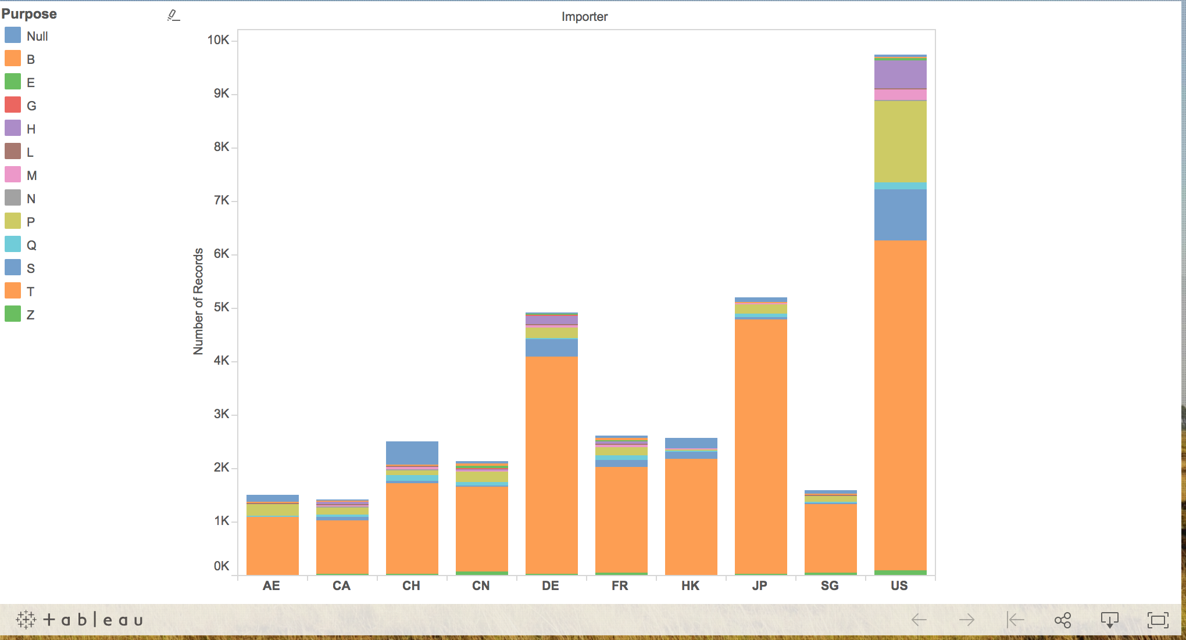
Import country
Among top 10 importers, all of they import wildlife mainly for commercial use. Then is for personal and scientific.

Slide 18
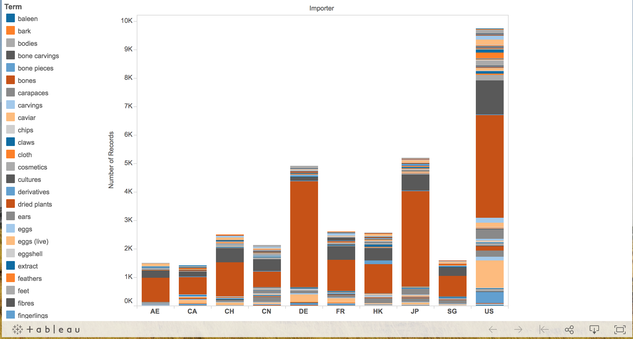
Import country
Terms imported most by them are live, then leather product and specimens.

Slide 19
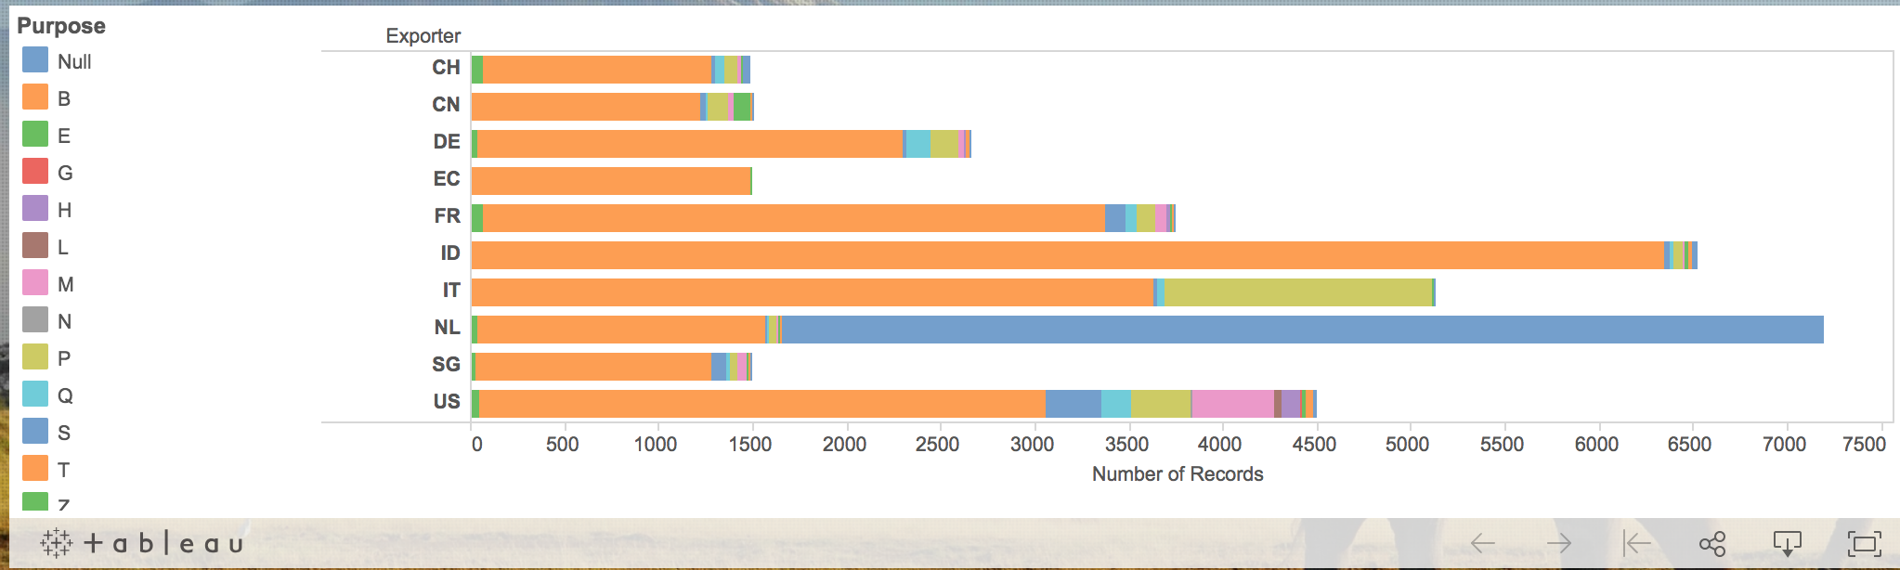
Export country
Among top 10 exporters, most of they exported wildlife also for commercial use. But there's huge part of nan records in Netherlands.

Slide 20
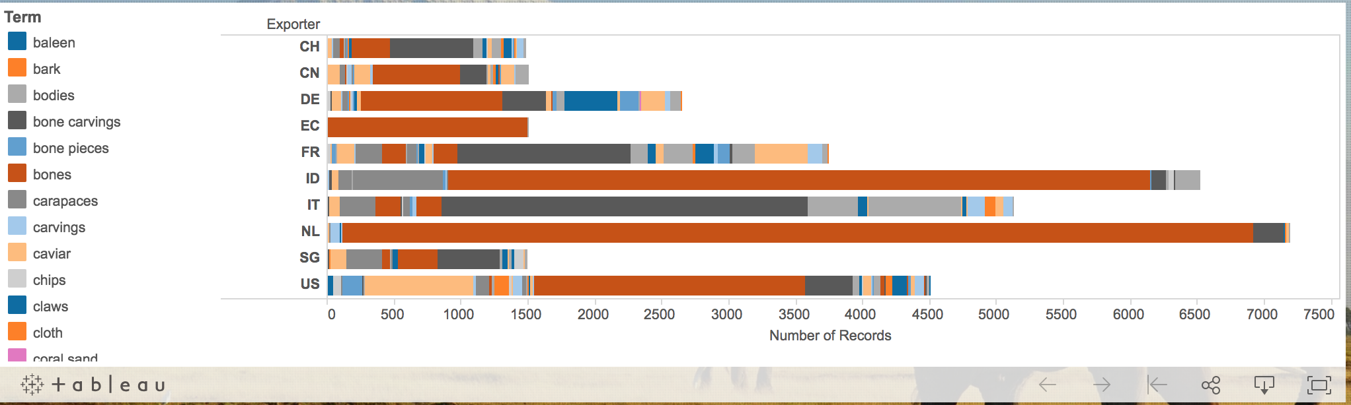
Export country
Terms exported most by them are as live, then leather product, specimens and garments. For Netherlands, they traded live the most.

Slide 21
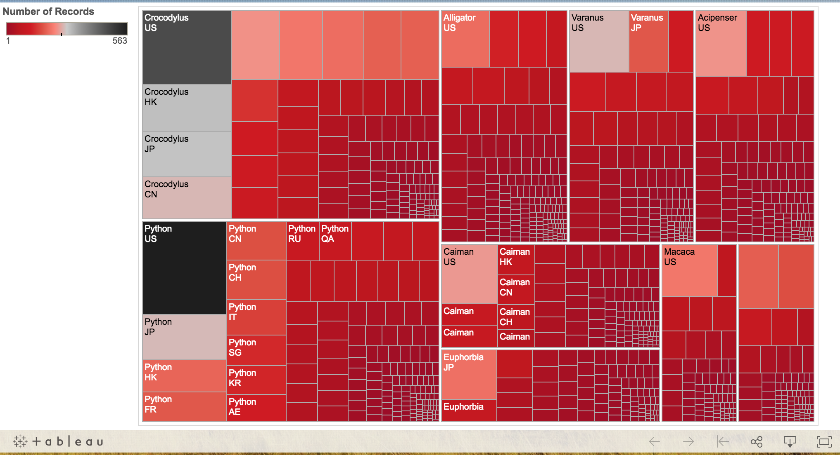
Importers and top genus
Combining with top 10 genus, US imported every genus the most.

Slide 22
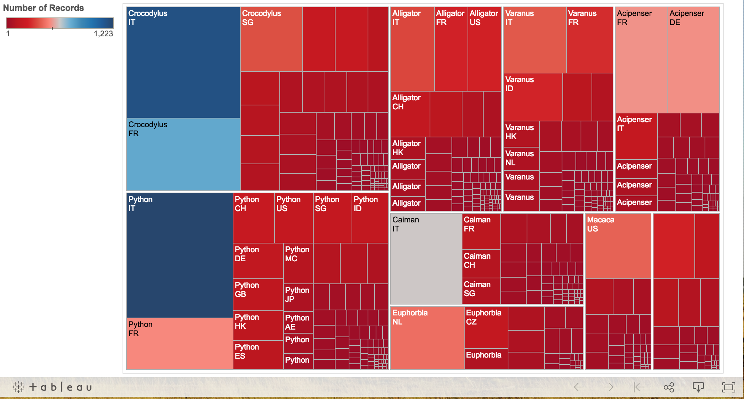
Exporters and top genus
From exporters and top genus chart, it seems that Italy exported every genus the most. So why did Netherlands is the country with highest export number?

Slide 23
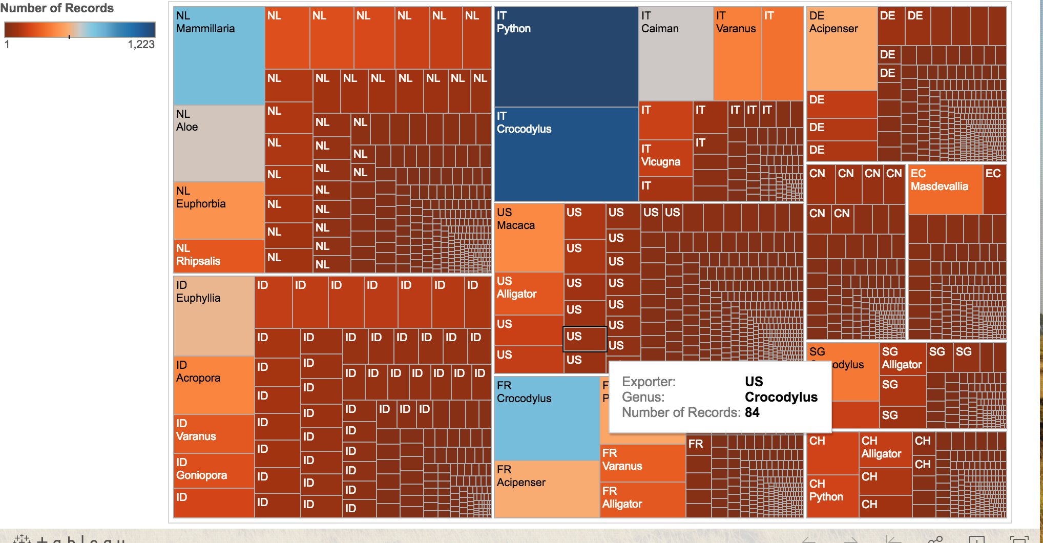
Top Exporters and genus
It is easy to see that actually Netherlands exported plants the most since Mammillaria, Aloe, Euphorbia, Rhipsalis are all pants. And related to real life, it is very reasonable.

Slide 24
Conclusion
Most of the wildlife are traded for commercial use as live, leather products. Most of the trades happened in northern part of earth. Although they are legal, but still represents a major threat to biodiversity. Animals are captured, killed and traded live or in parts for a number of purposes. Needless to say the trade in black market.

Slide 25
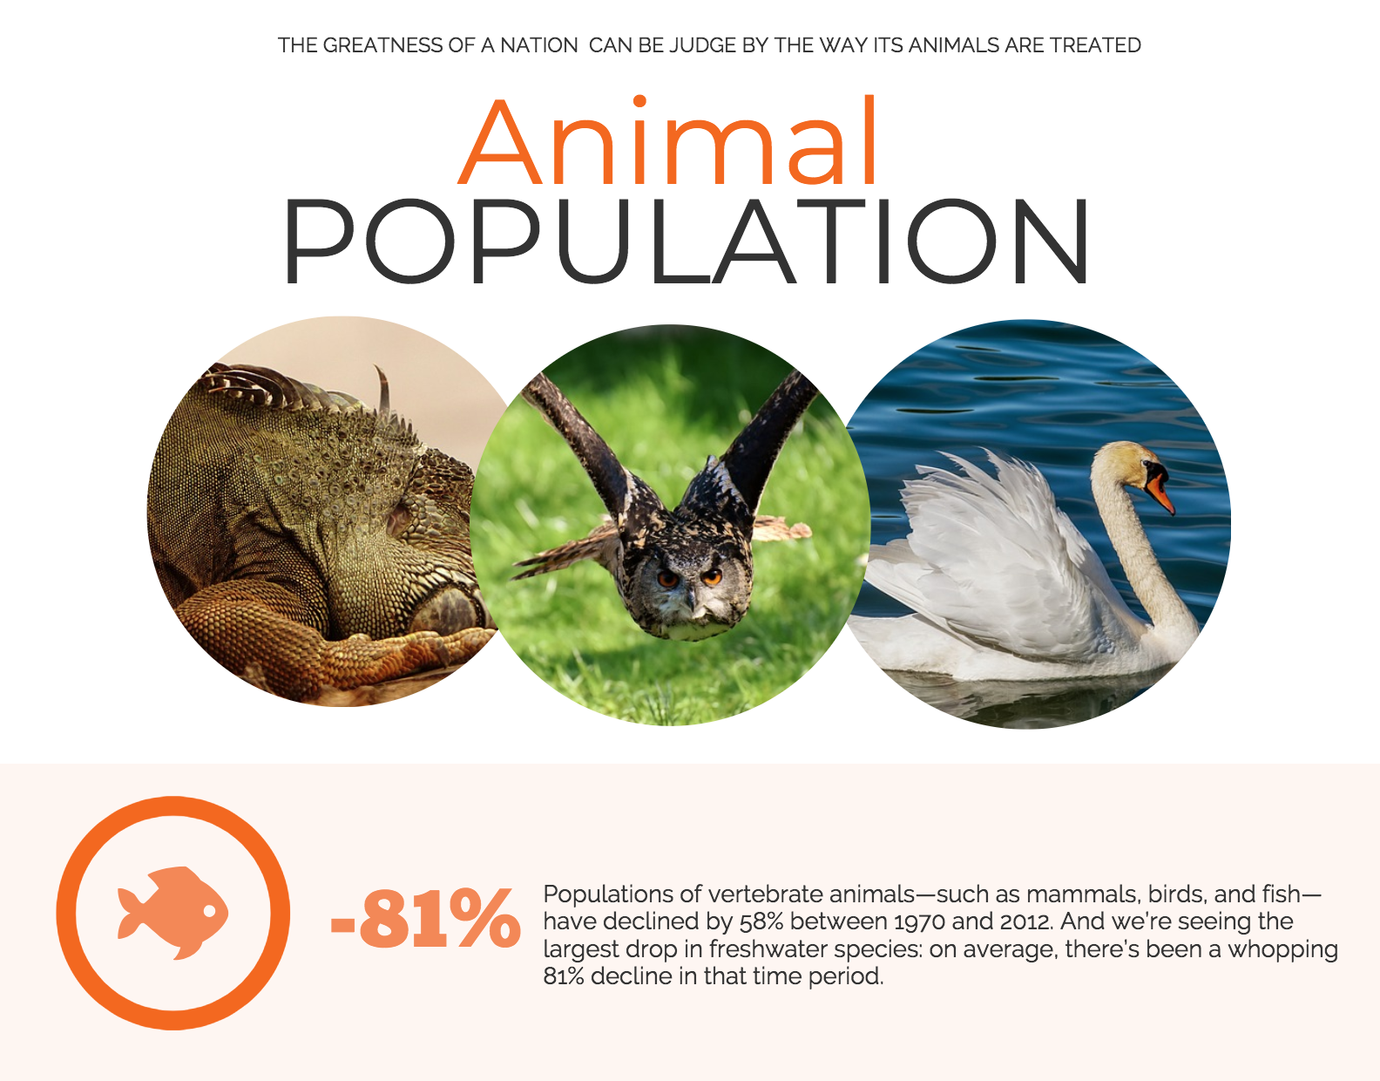
Infographic
In terms of animal population, it is decreasing every year and some species has already been on the brink of extinction. More strict rules should be set for wildlife trade.

Slide 26
Learnt
Various way to demonstrate visualization： D3 Plotly Tableau Infographic
How to place and structure a website
More proficient and experienced in CSS HTML

